Slide 1
Fundamental Concepts in Java Programming
Bal Krishna Subedi
St. Xavier’s College
Prepared by Bal Krishna Subedi

Slide 2
Operators in Java
Arithmetic Operator
Logical Operator
Bitwise Operator
Assignment Operator
Prepared by Bal Krishna Subedi

Slide 3
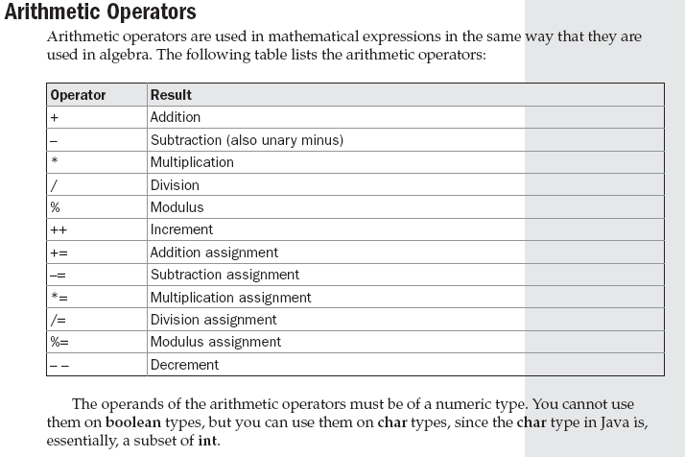
Prepared by Bal Krishna Subedi

Slide 4
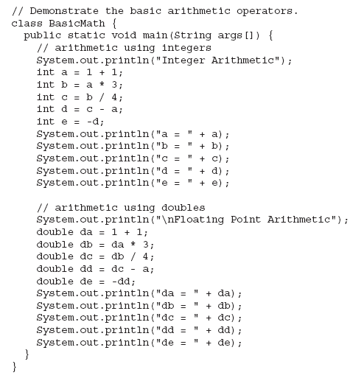
Example of Arithmetic Operators
Prepared by Bal Krishna Subedi

Slide 5
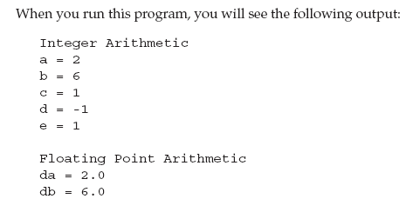

Prepared by Bal Krishna Subedi

Slide 6
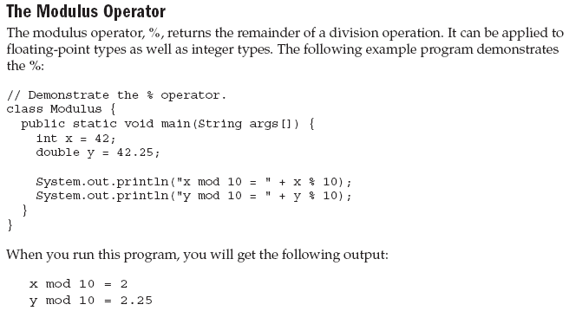
Prepared by Bal Krishna Subedi

Slide 7
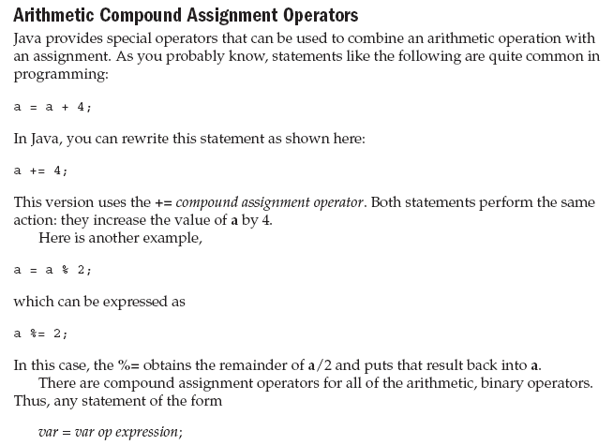

Prepared by Bal Krishna Subedi

Slide 8
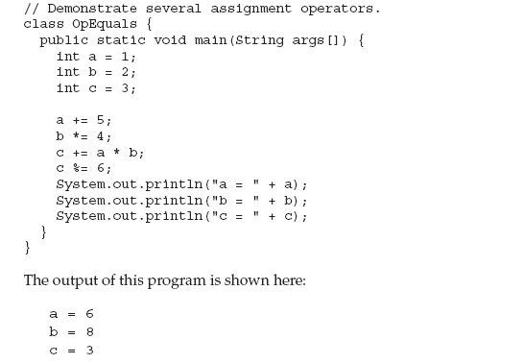
Prepared by Bal Krishna Subedi

Slide 9
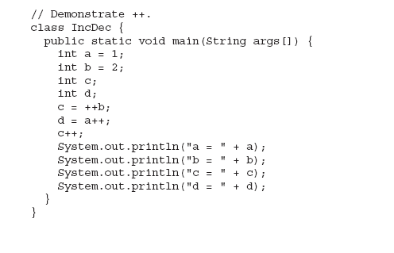
Increment & Decrement Operators with Example
Prepared by Bal Krishna Subedi

Slide 10
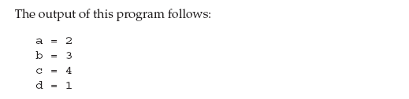
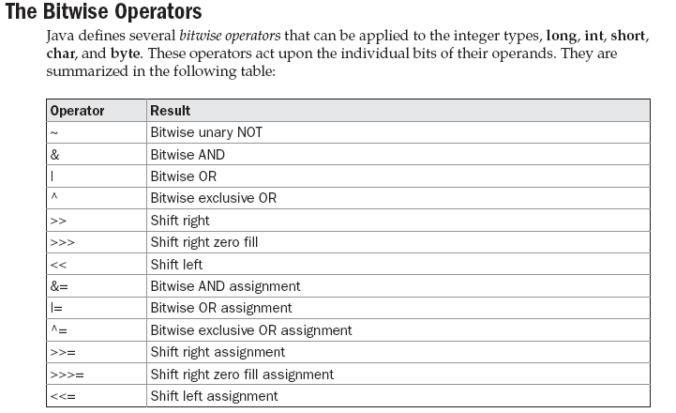
Prepared by Bal Krishna Subedi

Slide 11
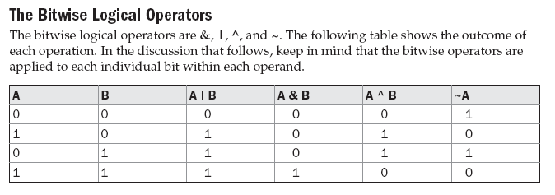
Prepared by Bal Krishna Subedi

Slide 12
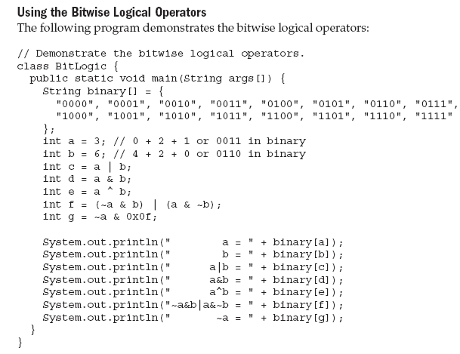
Prepared by Bal Krishna Subedi

Slide 13
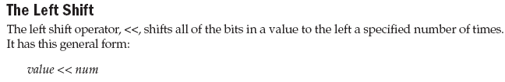

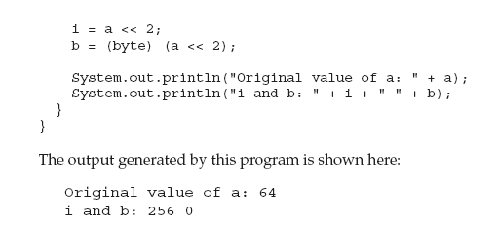
Prepared by Bal Krishna Subedi

Slide 14

Prepared by Bal Krishna Subedi

Slide 15
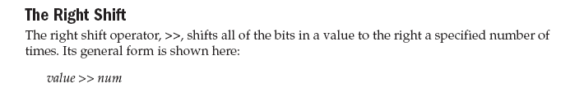
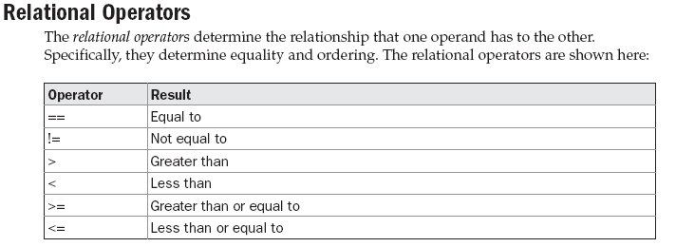
Prepared by Bal Krishna Subedi

Slide 16
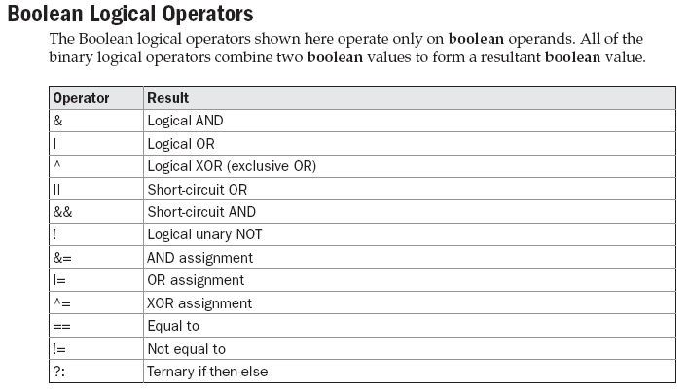
Prepared by Bal Krishna Subedi

Slide 17
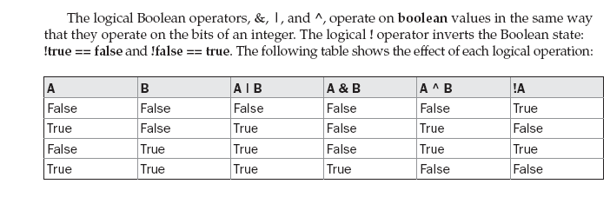
Prepared by Bal Krishna Subedi

Slide 18
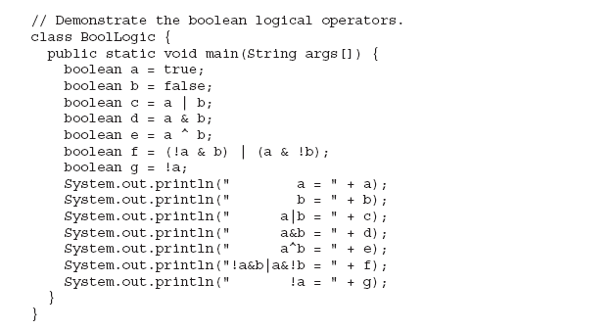
Prepared by Bal Krishna Subedi

Slide 19
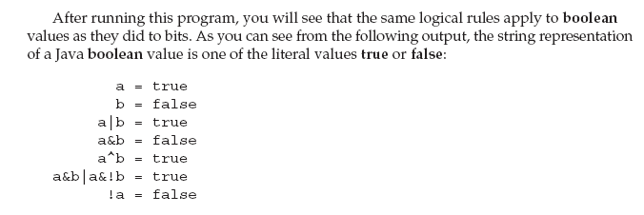

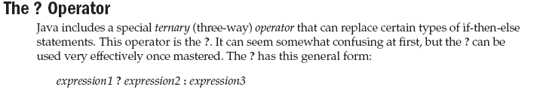
Prepared by Bal Krishna Subedi

Slide 20
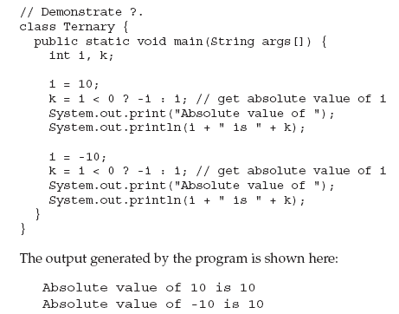
Prepared by Bal Krishna Subedi

Slide 21
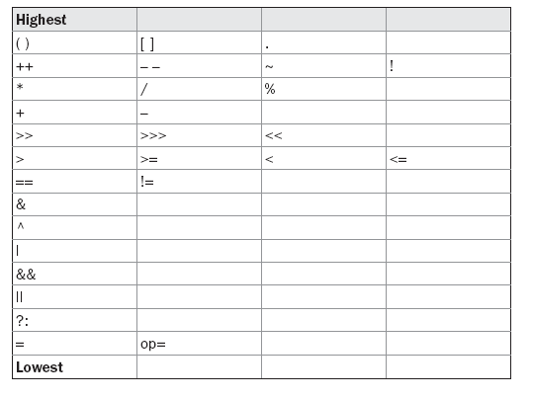
Precedence of Operators
Prepared by Bal Krishna Subedi

Slide 22
Control Statements
If Statement
If else Statement
Nested if statement
Switch statement
Prepared by Bal Krishna Subedi

Slide 23
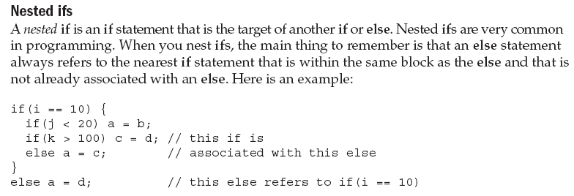
Prepared by Bal Krishna Subedi

Slide 24
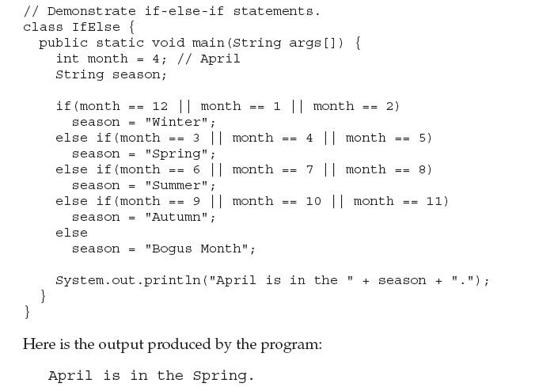
Prepared by Bal Krishna Subedi

Slide 25
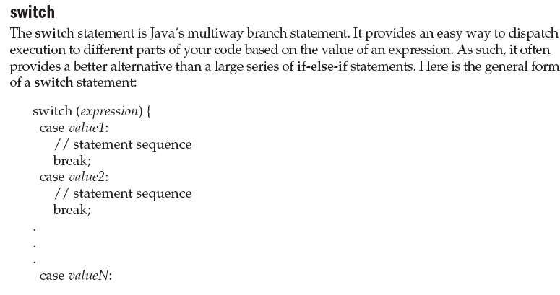
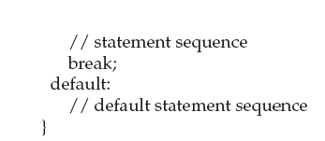
Prepared by Bal Krishna Subedi

Slide 26
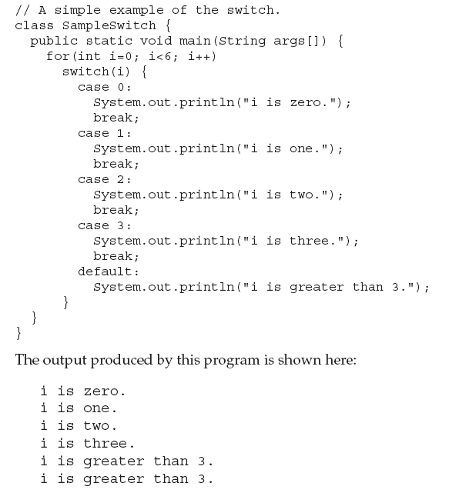
Prepared by Bal Krishna Subedi

Slide 27
Iteration Statements
While Statement
Do while Statement
For loop Statement
Nested for loop
Prepared by Bal Krishna Subedi

Slide 28
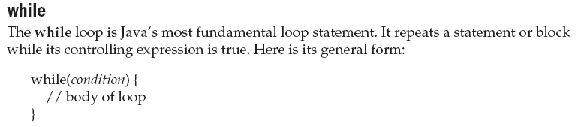
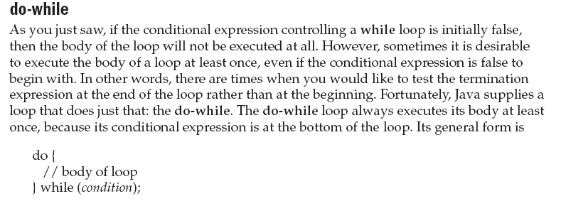
Prepared by Bal Krishna Subedi

Slide 29
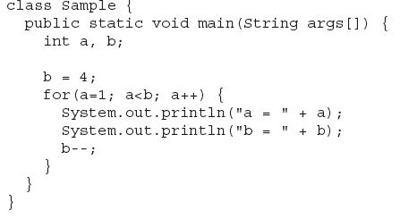
For Loop & it’s Examples
Prepared by Bal Krishna Subedi

Slide 30
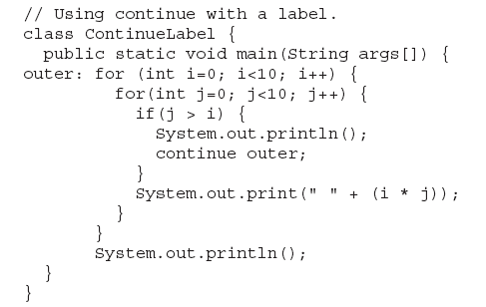
Prepared by Bal Krishna Subedi

Slide 31
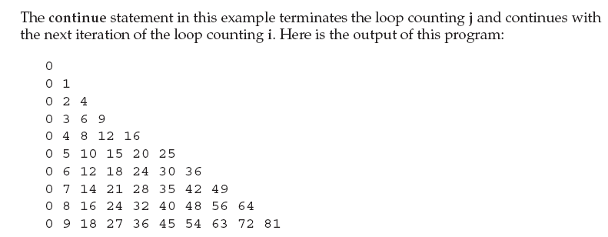
Prepared by Bal Krishna Subedi

Slide 32
Concept of Class & Object
What is Class?
What is object?
Object vs. instance.
What is method?
Prepared by Bal Krishna Subedi

Slide 33
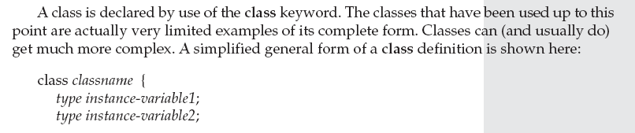
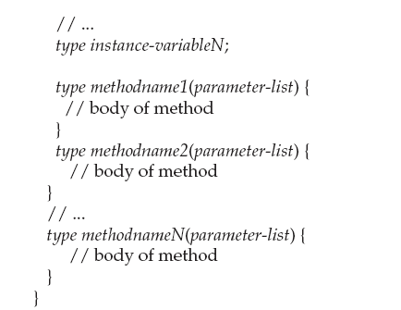
Introduction of Class
Prepared by Bal Krishna Subedi

Slide 34
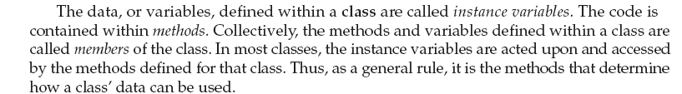
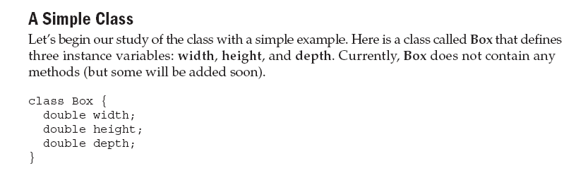
Prepared by Bal Krishna Subedi

Slide 35
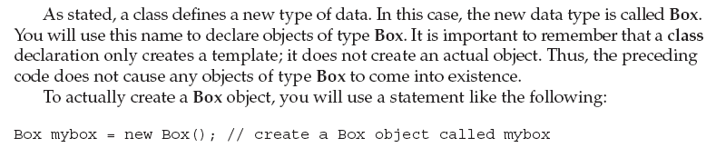

Prepared by Bal Krishna Subedi

Slide 36
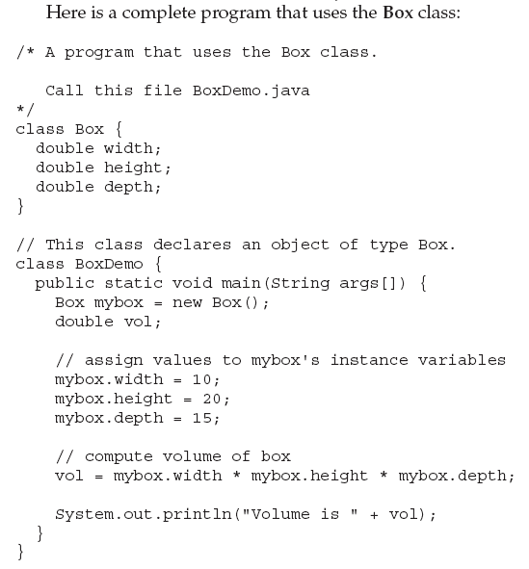
Prepared by Bal Krishna Subedi

Slide 37

Prepared by Bal Krishna Subedi

Slide 38
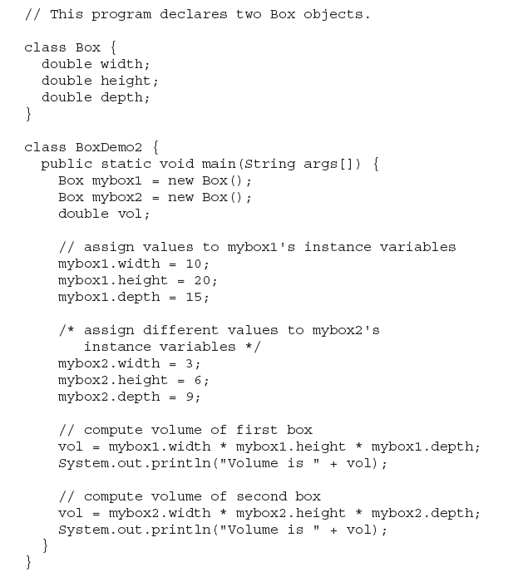
Prepared by Bal Krishna Subedi

Slide 39

Prepared by Bal Krishna Subedi

Slide 40
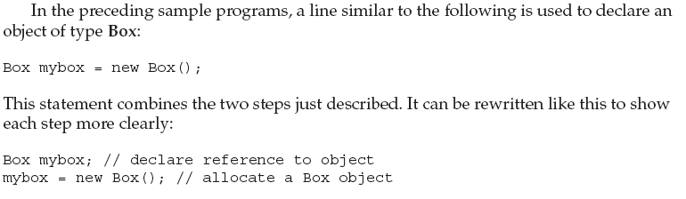
Declaring Objects
Prepared by Bal Krishna Subedi

Slide 41
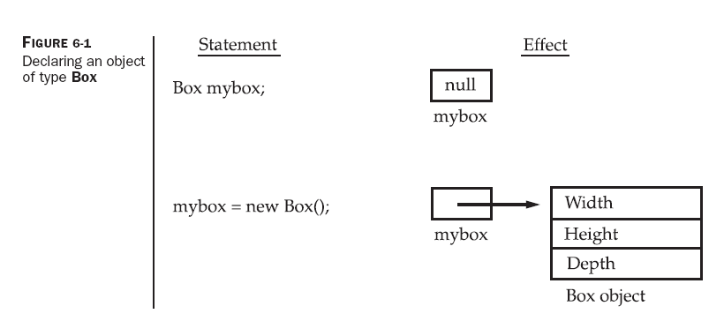
Prepared by Bal Krishna Subedi

Slide 42
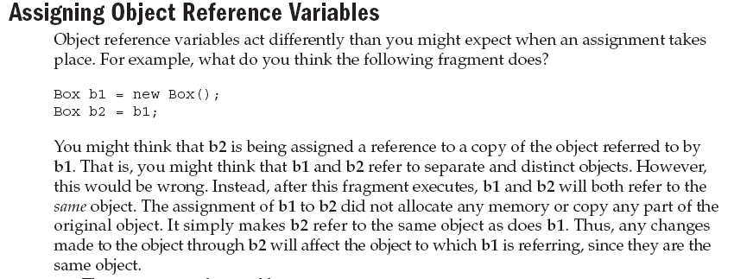
Prepared by Bal Krishna Subedi

Slide 43
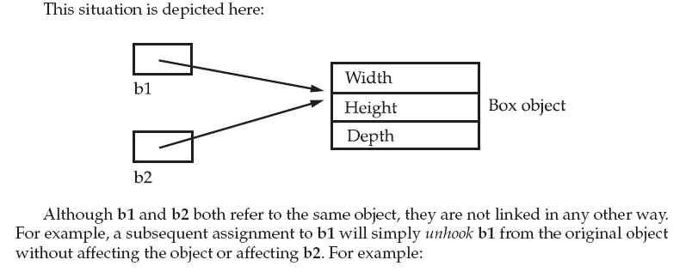
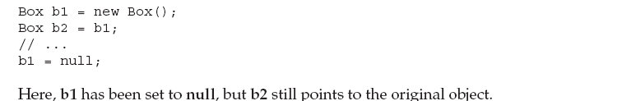
Prepared by Bal Krishna Subedi

Slide 44
Lab Assignment
Write a java program to find factorial values of any given numbers using class & object.
Write a java program to calculate area of rectangle.
Write a java program to transpose given matrix.
Prepared by Bal Krishna Subedi

Slide 45
Thanks you!
Any Queries??
Prepared by Bal Krishna Subedi

